Slide 1
Digital Portfolio
STUDENT NAME: KIRUDHAYA.S
REGISTER NO /NMID: 2422K1256/96FC3F30550AD9AA5904FBACABB54EC3
DEPARTMENT: COMPUTER SCIENCE
COLLEGE: COLLEGE/ UNIVERSITY Maharani arts and science college/Bharathiyar University

Slide 2
PROJECT TITLE
Creative personal portfolio with 3D animation and interactive ui

Slide 3


AGENDA
Problem Statement
Project Overview
End Users
Tools and Technologies
Portfolio design and Layout
Features and Functionality
Results and Screenshots
Conclusion
Github Link
3/21/2024 Annual Review

Slide 4

PROBLEM STATEMENT
Students often lack a personalized, creative digital portfolio to showcase skills, academic projects, and achievements.Existing platforms (like LinkedIn or basic resumes) do not provide interactive or 3D experiences.There is a need for a user-friendly, visually engaging portfolio that highlights creativity along with technical skills.

Slide 5

PROJECT OVERVIEW
The project focuses on developing a Creative Personal Portfolio Website using HTML, CSS, and JavaScript.It includes 3D animations and interactive UI to make the portfolio more engaging.The portfolio highlights profile details, technical skills, academic projects, and achievements.

Slide 6

WHO ARE THE END USERS?
Students – to present skills and projects for academic purposes
Job Seekers – to share an interactive portfolio with recruiters
Freelancers/Designers – to showcase creative works in a visually appealing format.
Organization– can use as a template to represent their team members.

Slide 7

TOOLS AND TECHNIQUES
Frontend Languages: HTML, CSS, JavaScriptDesign Techniques: CSS 3D transforms, animations, transitionsEditor: VS CodeVersion Control: Git & GitHub

Slide 8
POTFOLIO DESIGN AND LAYOUT
Header Section: Profile photo, name, and tagline.About Section: Personal details, education, and skills.Projects Section: Interactive 3D cards with project details.Resume Section: Downloadable PDF resume.Contact Section: Email, phone, and GitHub link.
8

Slide 9
FEATURES AND FUNCTIONALITY
Profile photo with hover animations.3D interactive cube highlighting UI/Design/Code skills.Responsive design (works on mobile & desktop).Modal pop-up for contact information.Downloadable resume option.Interactive project cards with hover effects

Slide 10
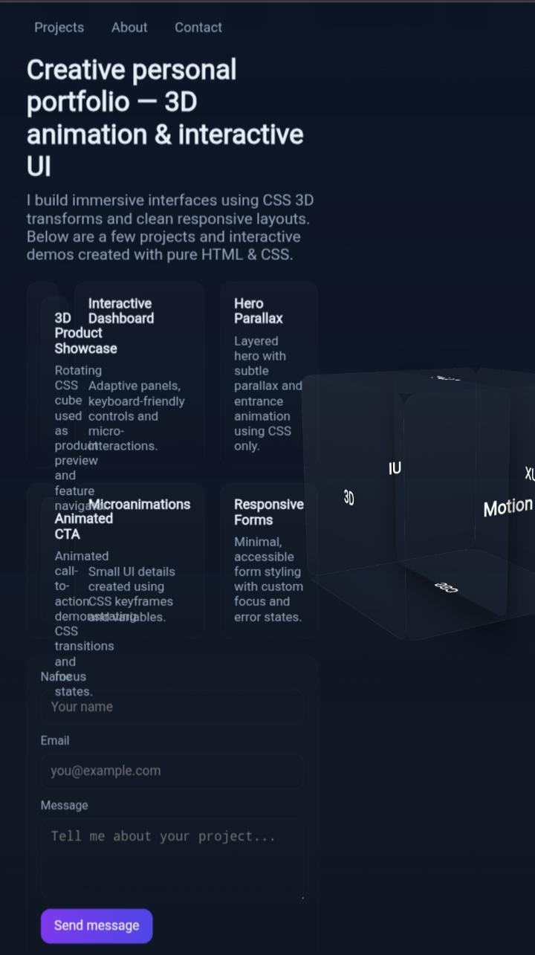
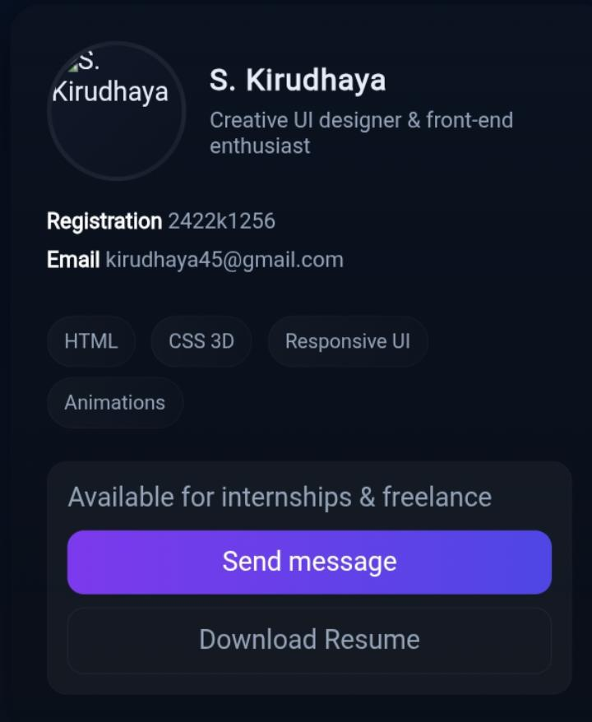
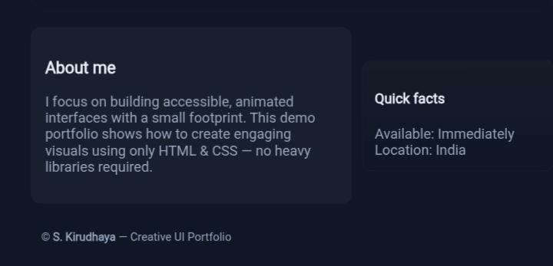

RESULTS AND SCREENSHOTS
3/21/2024 Annual Review
10

Slide 11
CONCLUSION
The project provides a modern alternative to static resumes.Helps users present themselves in a professional yet creative way.Portfolio can be extended with more sections (blogs, certifications, achievements).A valuable project for students and job seekers.
11

